Slide 1


LEARNING RECOMMENDATION SYSTEM

Slide 2

PROJECT LEADERSHIP
RITENDU BHATTACHARYA
Data Scientist @ 360DigiTMG |
Python, Data Science
Hyderabad, Telangana, India

Slide 3
TEAM MEMBERS
NAME: AKHILA GAJJALA
www.linkedin.com/in/akhila-gajjala

Slide 4
CONTENTS
Business Objective
Business Constraints
Project Architecture
Data Collection & Details
Model Building
Evaluation
Deployment

Slide 5
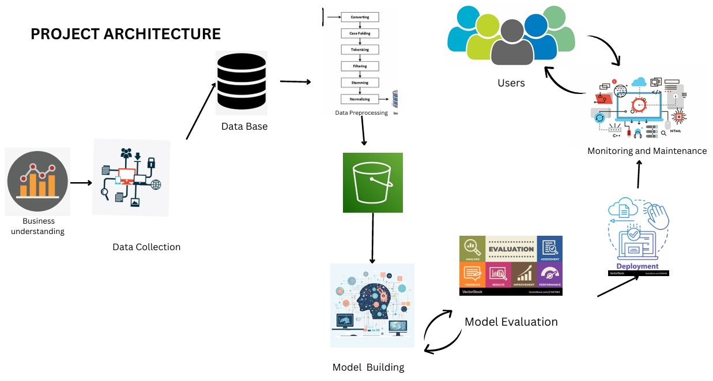
PROJECT ARCHITECTURE

Slide 6
BUSINESS PROBLEM
After getting all of the status and information of the knowledge, candidates get blank what to do next to get shortlisted in the interview.

Slide 7
BUSINESS OBJECTIVE & CONSTRAINT
OBJECTIVE:
Maximize the percentage of getting the job.
CONSTRAINT:
Minimize the mental stress of not getting a job.

Slide 8
CRISP-ML(Q) METHODOLOGY
There are six stages of CRISP-ML(Q) Methodology
Business and data understanding
Data preparation
model building
Model evaluation
Model deployment
Monitoring and maintenance

Slide 9
TECHNICAL STACKS
Operating System: Windows 11
Programming Language: Python (Spyder app, Google Colab is used)
Database: MySQL WorkbenchWeb
Framework: Streamlit

Slide 10
DATA COLLECTION AND UNDERSTANDING
Data set consists of flow of students who are enrolled in a course.
It is a step-by-step process which shows the path to get a job.
The Gemma 1.1 7B IT model, developed by Google, was trained on a diverse dataset comprising approximately 1.3 trillion tokens.

Slide 11
SYSTEM REQUIREMENTS
Hardware Requirements:
Adequate CPU, RAM, and storage space.
Optionally, a GPU for accelerated deep learning tasks.
Software Requirements:
Python as the primary programming language.
Relevant ML libraries and frameworks (e.g., langchain-huggingface, huggingface_hub, transformers).
Development environment (e.g., VS code, Google collab).
MySQL Workbench for database connection
Compatible operating system (e.g., Windows, macOS, Linux).
Dependencies and Packages:
Use package managers like pip or conda to install necessary dependencies.
Consider setting up a virtual environment for managing project-specific dependencies.
Internet Connection:
Ensure a stable internet connection for downloading datasets, models, and libraries.
Access online resources and community support.
Scalability Considerations:
Cloud computing resources or distributed computing frameworks for large-scale or computationally intensive tasks

Slide 12
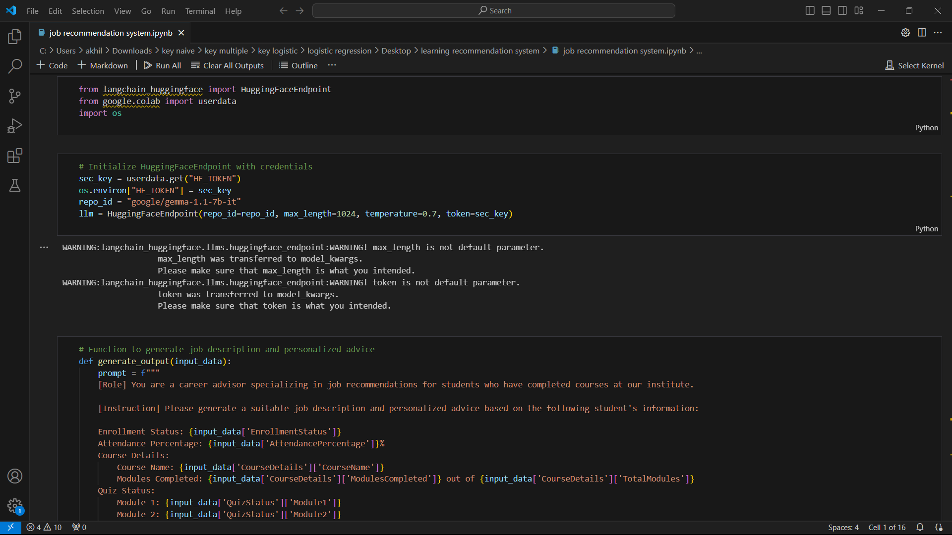
MODEL BUILDING

Slide 13

BEST MODEL
Google Gemma

Slide 14
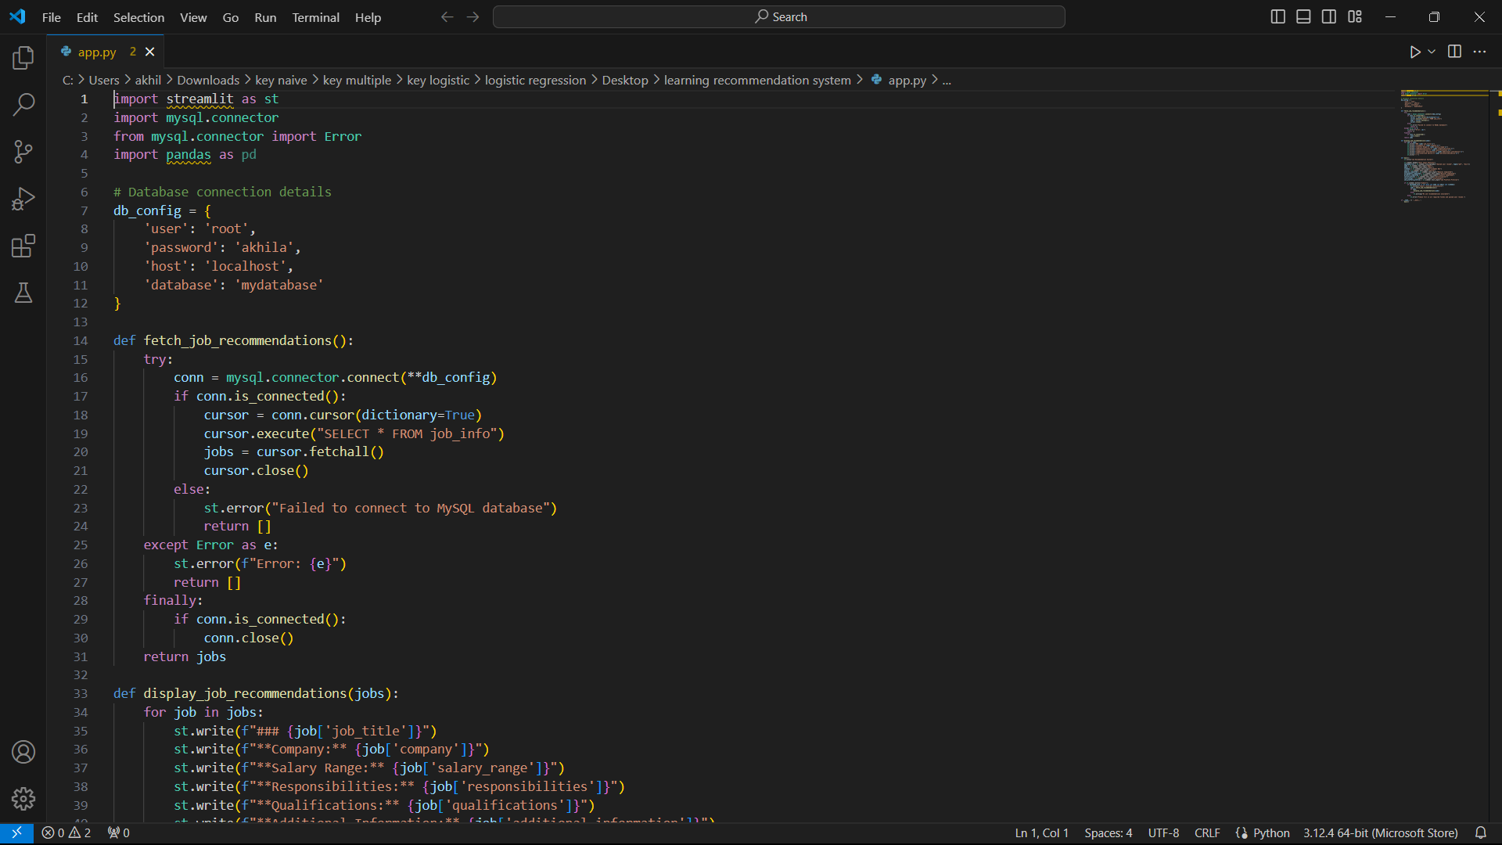
MODEL DEPLOYMENT

Slide 15
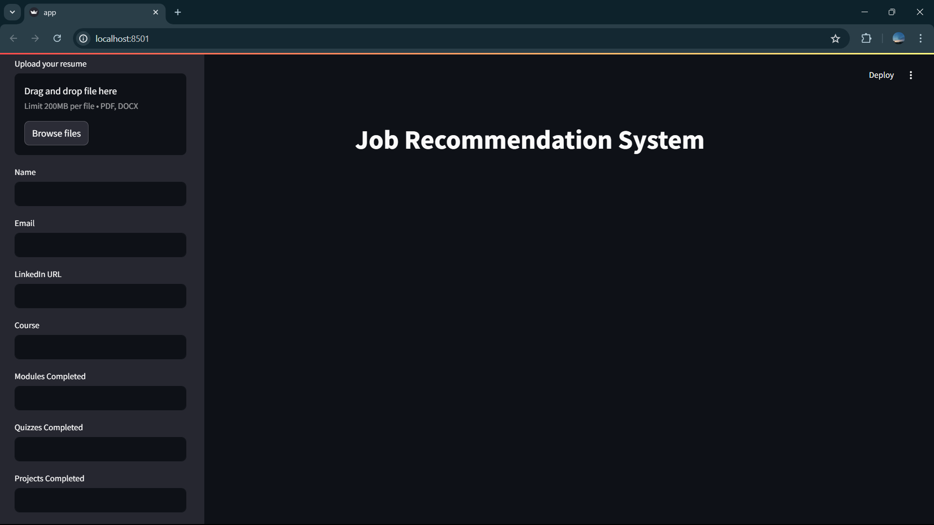
OUTPUT

Slide 16
CHALLENGES
Challenges include ensuring data quality, selecting relevant features and models, interpreting results, managing computational resources, deploying models.

Slide 17
FUTURE SCOPES
In the future, data science is expected to advance in areas such as AI, ML, big data analytics, IoT, deep learning, data privacy, automation, healthcare analytics, and finance. These advancements will drive innovation and impact across industries, shaping the future of technology and decision-making.

Slide 18

QUERIES?

Slide 19


